Slide 1

Visual Attention Modelling in 360 degrees
Design Credit -
Mentor : Manish Narwaria
Author : Devansh Bansal (B20CS094)
Diksha Jena (B20CS013)
Notes:
Good Evening/Morning everyone.
Myself Devansh Bansal, myself Diksha jena.
We worked during our last semester and winter vacation on the visual attention modelling for 360 degree image processing, as part of our design credit project.

Slide 2
Problem statement : modelling an optimum solution for the
storing of 360 degree image capturing
Improvements focus :(i) minimizing Data loss
(ii) minimizing image distortion
(iii) maintaining factors like quality,
depth, visual comfort, resolution
Notes:
With the advancement in the field of image capturing technology, and the much gaining popularity of 360 image, capturing the paranormal view with a field view of full horizontal cover; the capturing and storing methods for imaging also needs to be updated.
We worked towards improving the already existing methods, studying their pros and cons, coming with a optimum solution addressing the 2 main problems of image storage:
(i) data loss : that might occur while rendering the relevant data from our images
and (ii) image distortion : the occurs while changing the projections of the image, as transmission methods are only available for 2-dimensional planer images
various factors like image quality, depth quality, visual comfort, resolution, information etc were also considered, so that the overall image quality is the least affected and later be rendered without any distortion

Slide 3
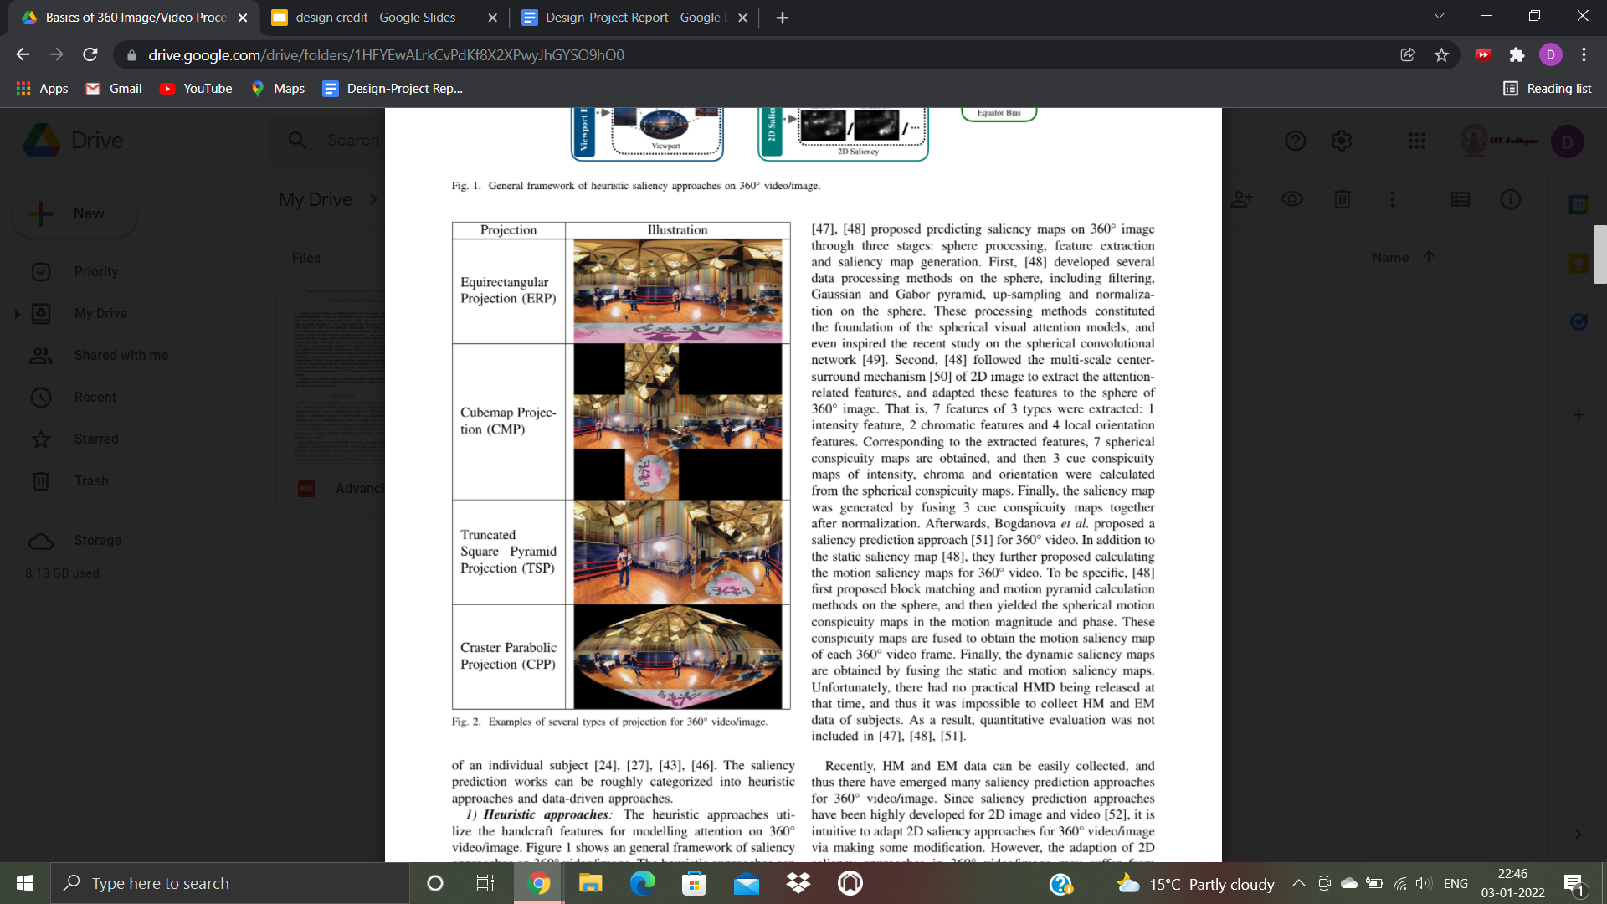
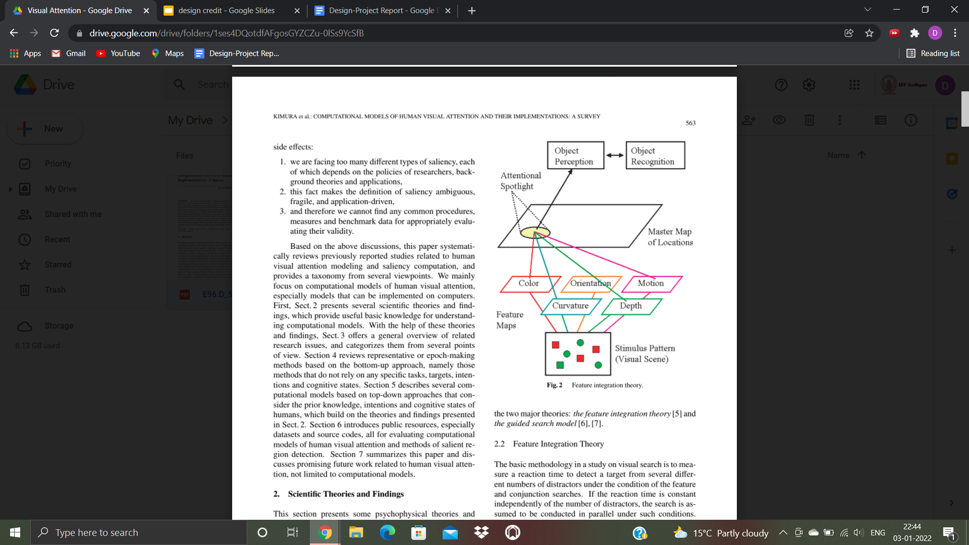
Past works done in the field
The four models studied:
using ML CNN trained model
using projection to equirectangular, and then computing saliency by and of the 2 methods : GBVS, Itti Koch
using cube map projections followed by GBVS or Itti Koch model
and a greedy approach that takes into account the viewport and tile downloading probabilities.
Notes:
Before working on the optimal solution, we studied the already available methods for the need and the points where they could be improved.
There were 4 methods
(i) using ML CNN trained model
(ii) using projection to equirectangular, and then computing saliency by and of the 2 methods : GBVS, Itti Koch
(iii) using cube map projections followed by GBVS or Itti Koch model
(iv) and a greedy approach that takes into account the viewport and tile downloading probabilities.
While the ML model, has fairly accurate results, its high memory requirement and slow processing speed makes it difficult to be of common use. In the other 2 methods however, the equirectangular projection induces lot of distortion especially at the north and south pole due to line effect, whereas the cubemap projection, does not takes the center bias effect into consideration, taking the view from any of the 6 angles to be the same.
Different approaches were available for various aspect of our problem:
Distorted planer imaging and multiple tangent planer projection for image projections.
Heuristic or Data Driven approach (top-down or bottom up approach) for visual attention.
Gaussian or gabor pyramid for data filtering, up-scaling or normalization.
Averaging or blur box technology accounting compression distortion and pixel wise distortion.
The input and output methods of the available codes were also noted, like the saliency methods would take in rgb image and return the mapping in grayscale format. The projection conversion codes would only work for a 3-D matrix (ie coloured images) and were available for equirectangular and cubemap projection only.

Slide 4
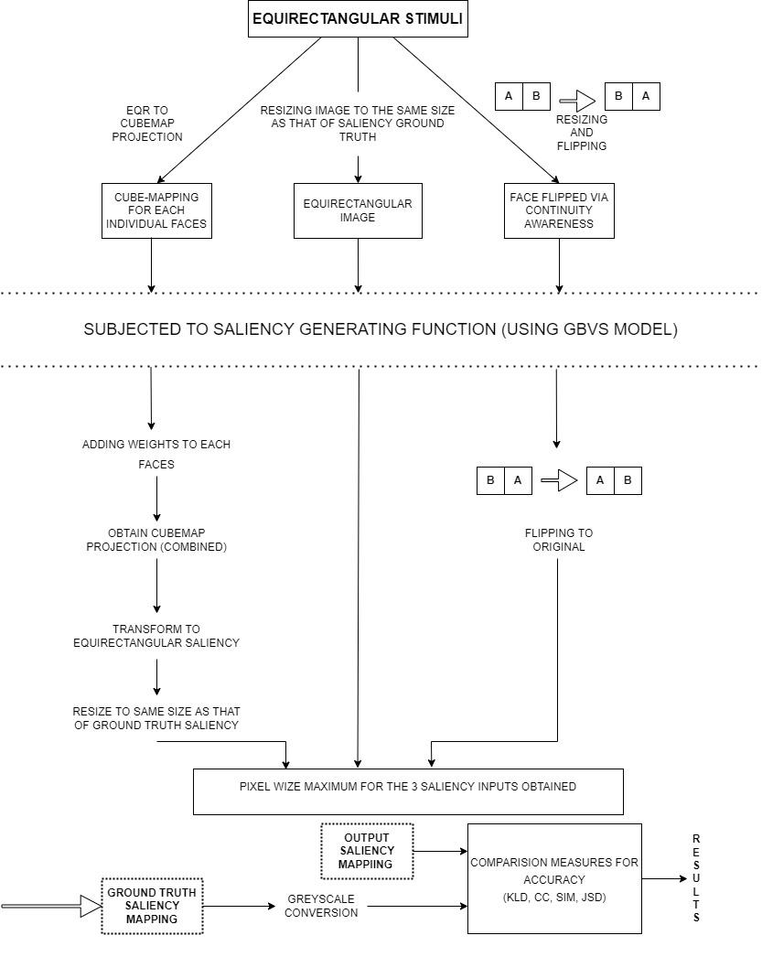
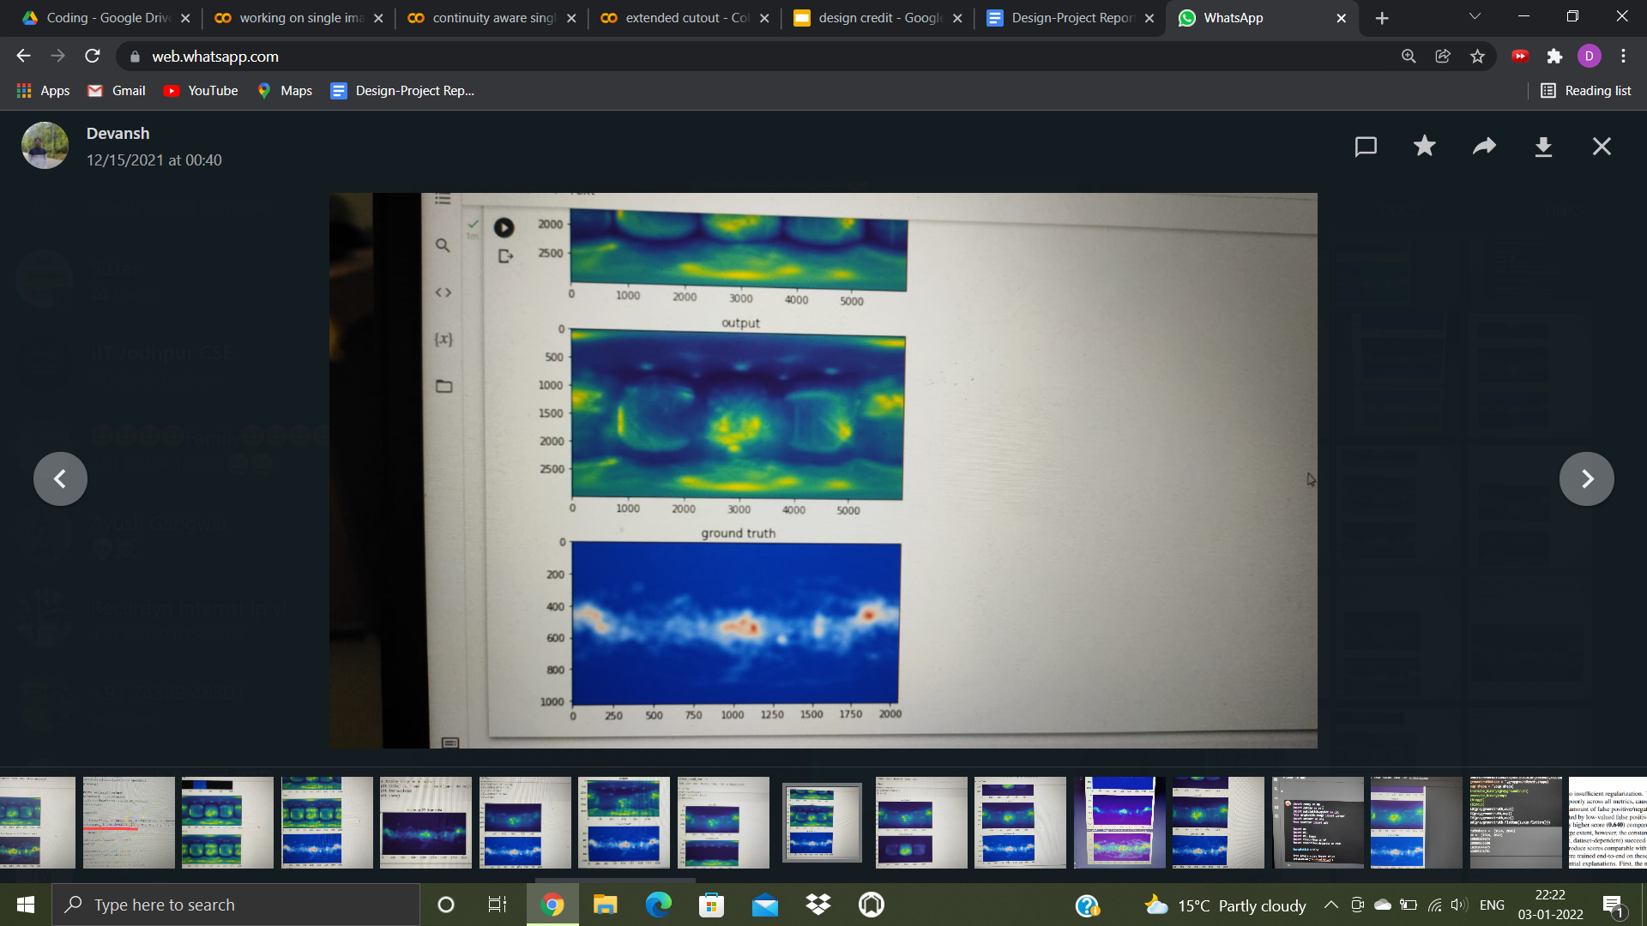
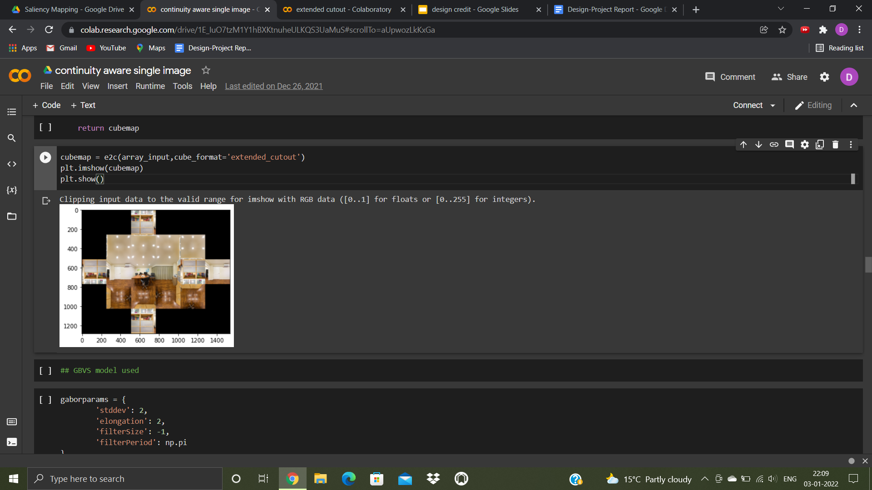
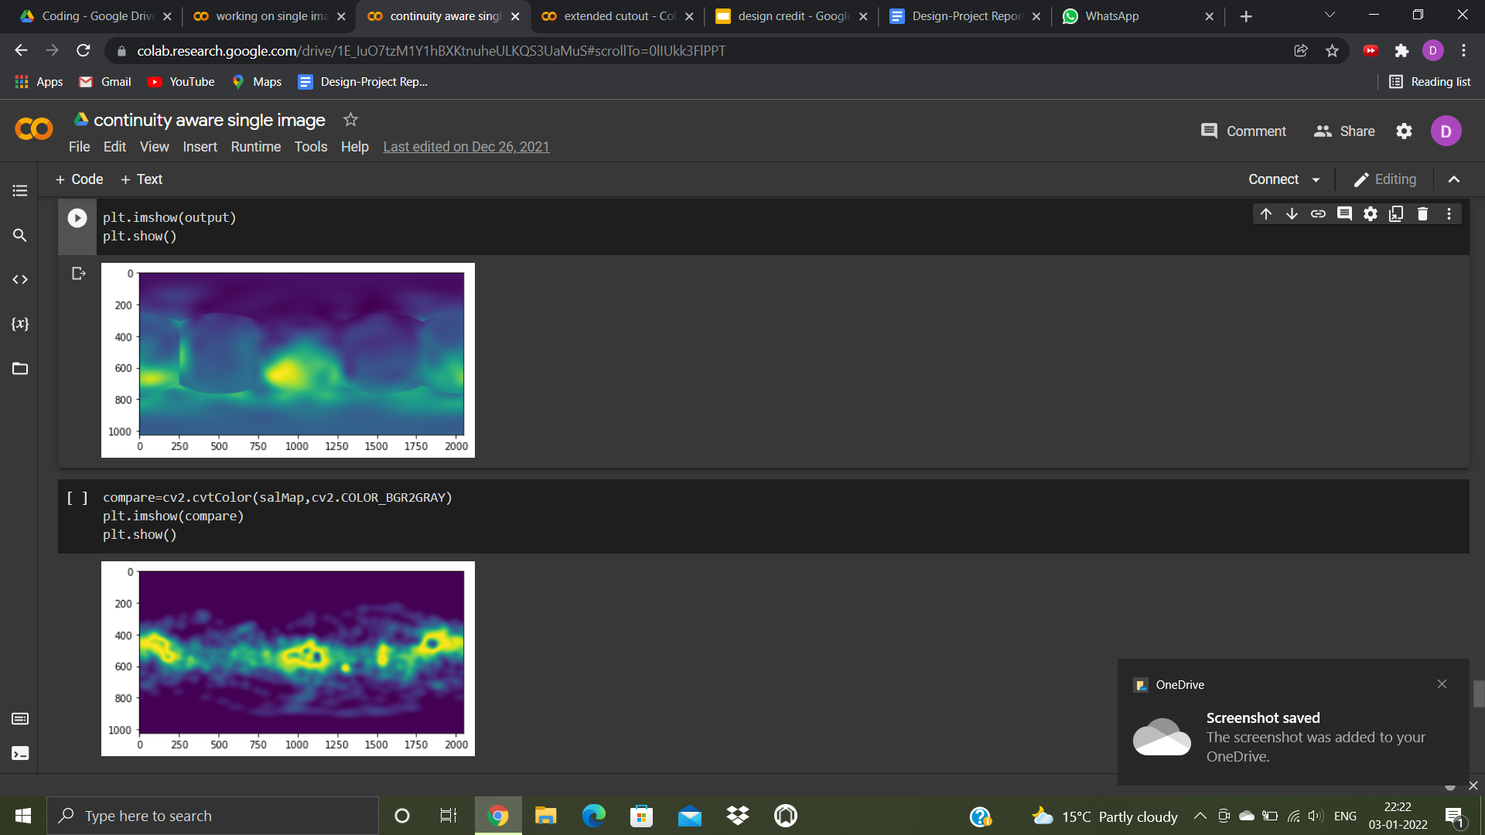
Methodology
Saliency output obtained using cubemap only
(i) resizing
(ii) newaxis, and np.squeeze
(iii) face weights
(iv) pixel wise maxima
Saliency output obtained using extended cut out
Notes:
For our final approach: here is a final flowchart showing the steps involved. It is to be noted that:
(i) resizing of image and ground truth saliency is required, so that they can be easily compared.
(ii) newaxis and np.squeeze were used to convert the matrices from 2D to 3D and vice versa.
(iii) weights were added taking into account the different probabilities of faces to be looked at, setting the values after observing their relative contributions from the ground truth saliency.
Our focus was placed towards improving the KLD and CC towards ideality and the other two measures were taken to verify the results.
Apart from the main method, we also implemented the extended-cube cut out method, and checked if using the extended cube projection instead of cube map projection would provide better results.
We also tried using ML to get best values for weights, but the results were varied for image to image and final selection could only be made on an observational basis.

Slide 5

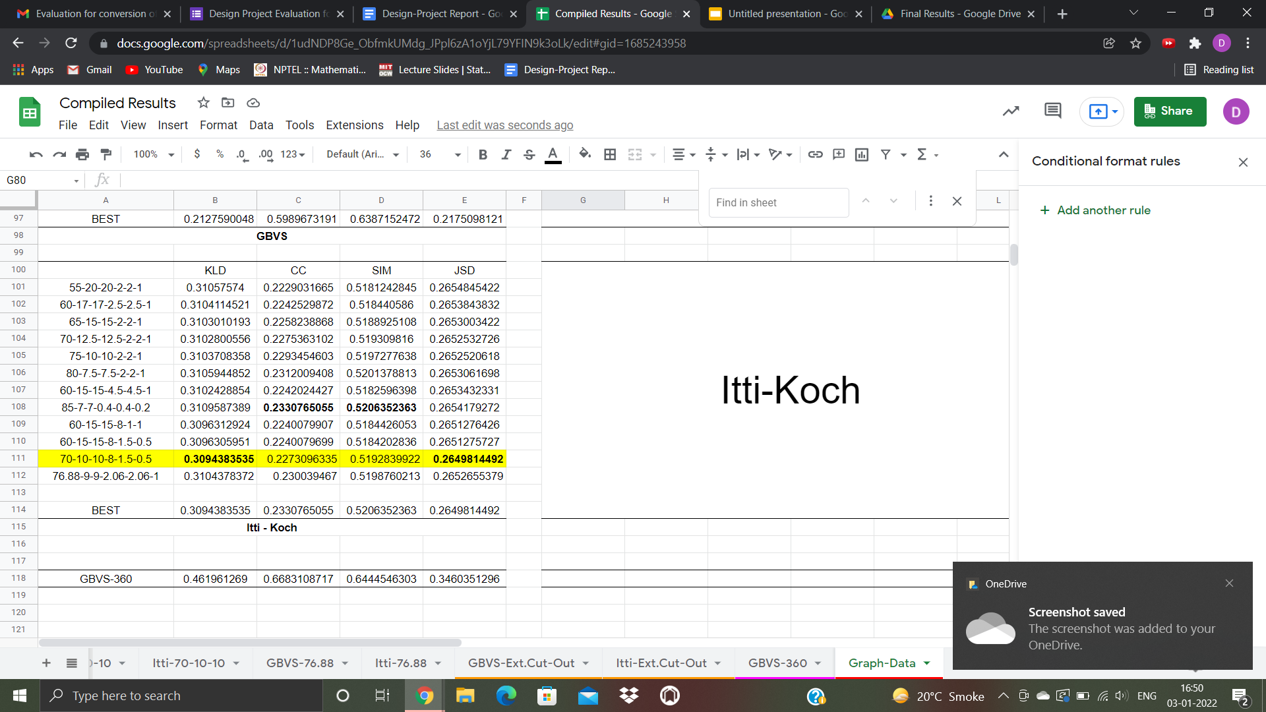
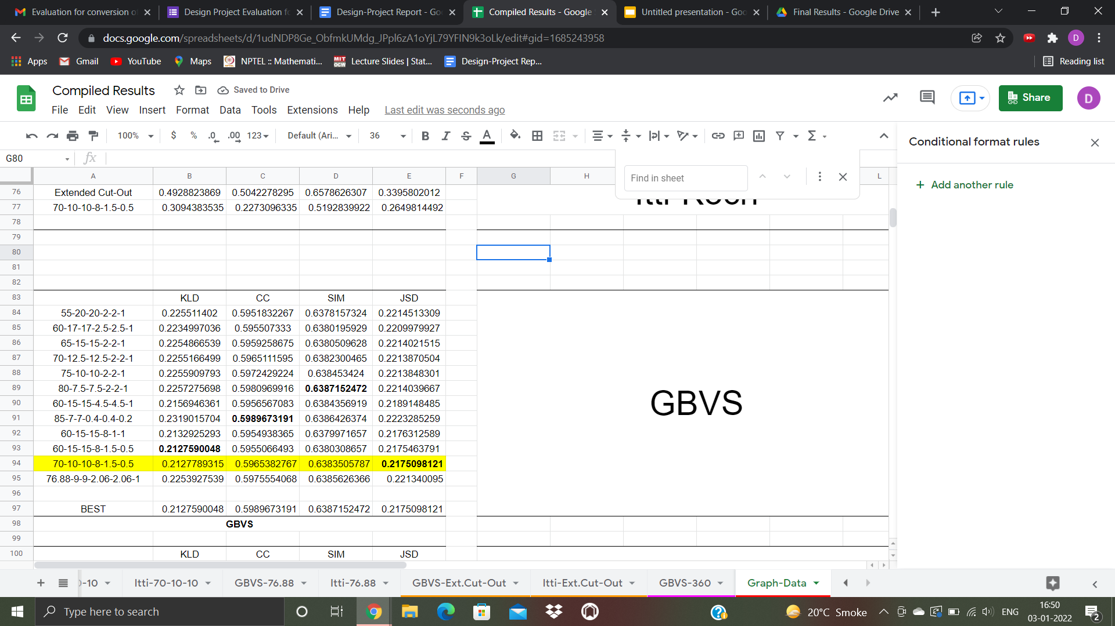
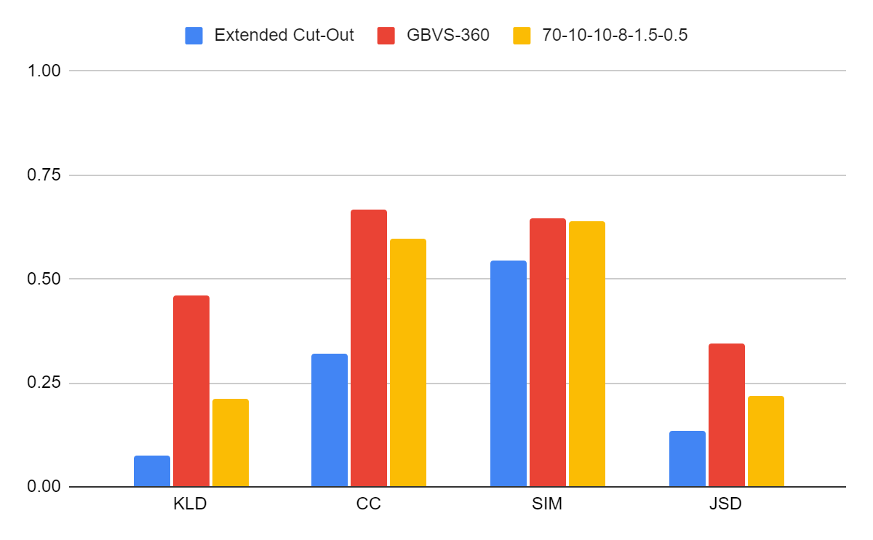
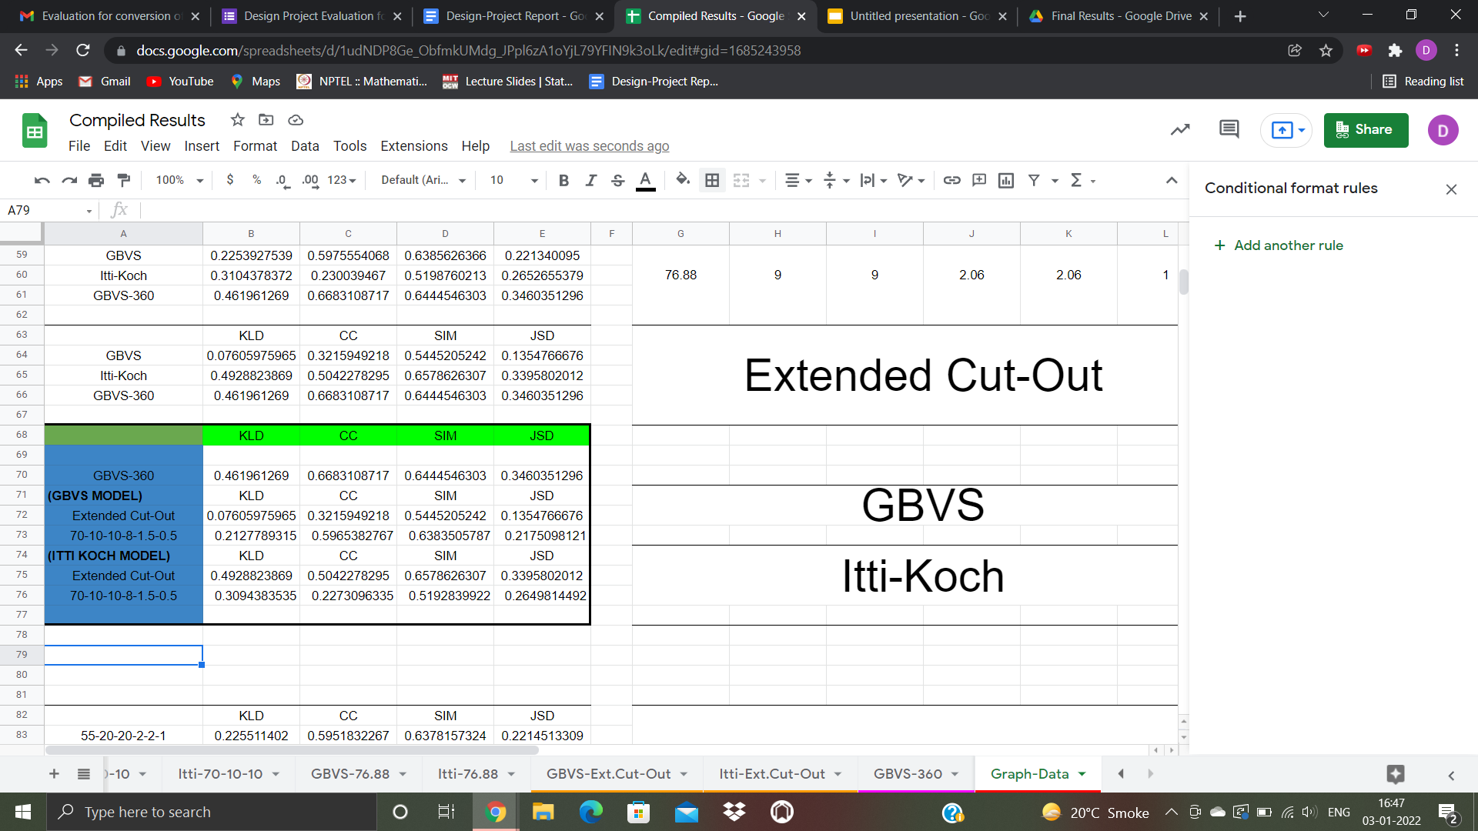
Observations, Results and Analysis
.
Notes:
For our results, we used 12 different values of possible face ratios and compared the results accuracy to settle for the best ratio. These ratios were chosen, based on the observation of contribution to ground truth saliency and logical thinking on a person's viewing perception when send to a room for a short period of time.
The best result result came out to be for the ratio highlighted in yellow ie {70-10-10-8-1.5-0.5} in the order of front, left, right, top bottom, back face. And was independent of whether the model chosen was GBVS or Itti Koch. This ratio had the best result in both cases, and thus finalized as our models working accuracy.
The effectiveness of our model was compared to that of GBVS360 model and Extended cut out model (that simply computes the saliency of extended cut-out and extracts the cube map part from it). The GBVS model had the better results as compared to itti-koch and was thus selected as the final model.
The graph here shows the comparison of our model (using face weights) to extended cutout model both using gbvs approach, and GBVS360.
As obvious from the graph, the extended cut out has the best results for KLD and JSD comparisons and GBVS360 has the results for CC and SIM comparisons. However, our models wins, in terms of overall comparison at all aspects.
The ideal value of KLD and JSD is 0 while that of CC and SIM is 1.

Slide 6

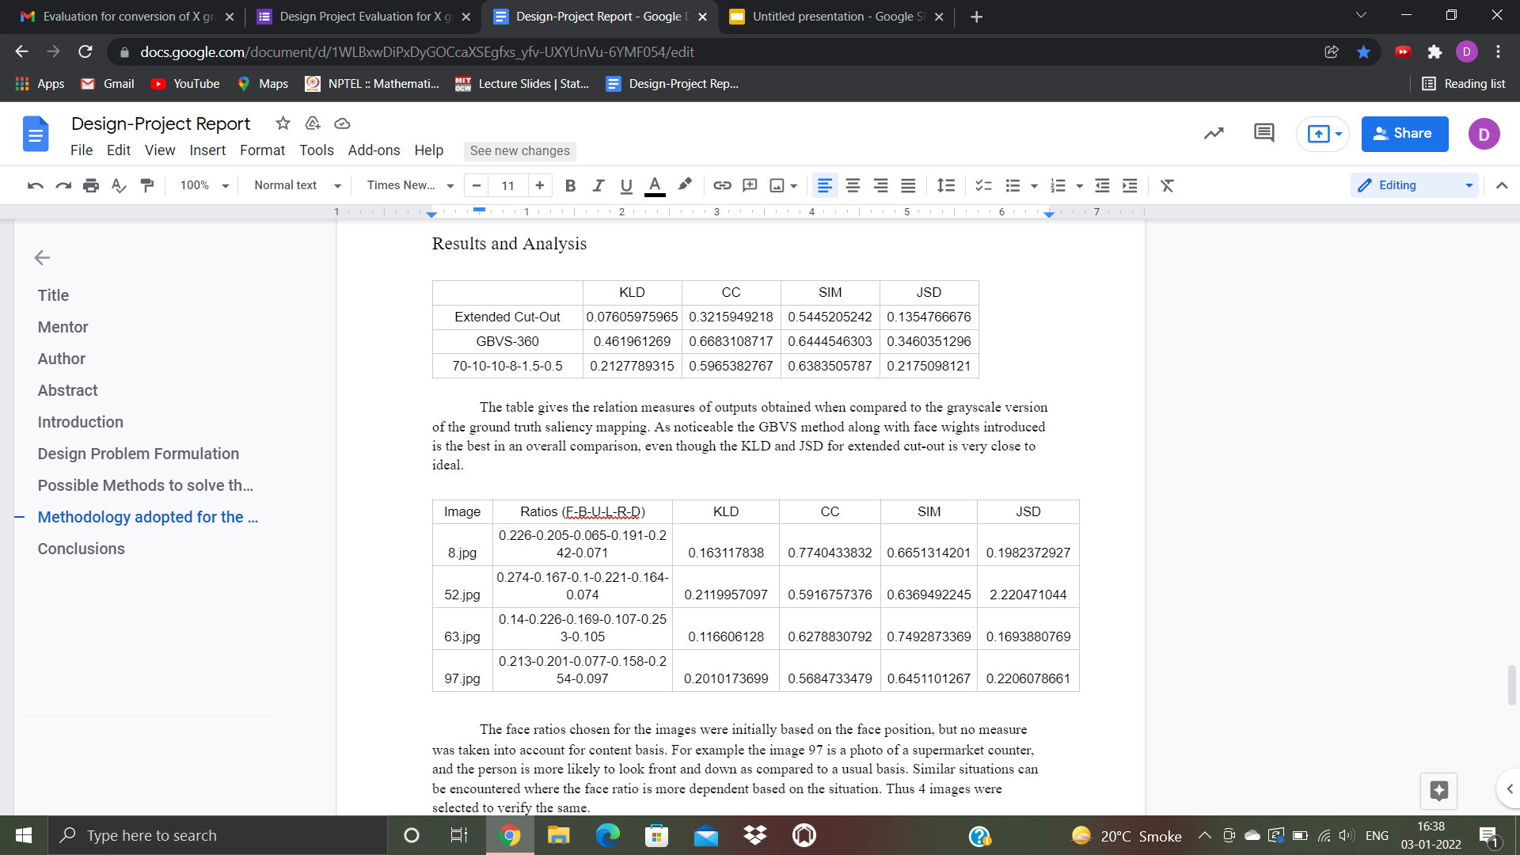
Possible improvements
Notes:
Even though our model is better than the existing model, there are still a few points that can be noted it it. For eg, while handling 3D images being converted to 2D images, the continuity was broken, so that needed to be corrected while calculating the final saliency output. Apart from this, approaches like non-linear regression or ones based on object identification can be used. It is to be noted, while the face weights are based on the general reaction of a human, it can still vary depending on the objects and situation our image. For eg looking from a counter of a convenience store, we our more likely to look at the bottom face, which is not the usual face of interest when we usually walk into a room. To prove this point of ours, we used 4 different images, captured for different situation and obtained the best face ratio as shown in this table. Its can be seen how different importance is demanded by the faces for different images depending on its object/content.
For a general purpose our model stands quite reliable. As our human eyes and the viewing mechanism of humans have evolved, face ratio is a good idea to be thought of and used to weigh each face for final saliency output. Also averaging various results may drop the value and essence of a correct result, so pixel-wise maximum is a better option for final saliency output.

Slide 7

References
https://www.researchgate.net/publication/335500379_Advancing_User_Quality_of_Experience_in_360-degree_Video_Streaming
https://support.apple.com/en-in/guide/motion/motnfccf9e10/mac
https://arxiv.org/pdf/1905.00161
https://www.researchgate.net/publication/344837879_360-Degree_Video_Streaming_A_Survey_of_the_State_of_the_Art
https://repository.kulib.kyoto-u.ac.jp/dspace/bitstream/2433/171749/1/IEICE_E96-D_3_562.pdf
http://www.cvlibs.net/publications/Coors2018ECCV.pdf
https://michaeldorr.de/salient360/360_aware_preprint.pdf
https://github.com/marcellacornia/sam
http://www.vision.caltech.edu/harel/share/gbvs/
https://github.com/sunset1995/py360convert
https://drive.google.com/file/d/1QEYkq9YCwe8egE6RgQtXCE43XbluFPAB/view?usp=sharing
Notes:
With this, we come to the end of our presentation. These are the references that we took help from, for completing our project.
THANK YOU FOR LISTENING

